Slide 1
@Target Annotation
@Target tag is used to specify at which type, the annotation is used.
The java.lang.annotation.ElementType enum declares many constants to specify the type of element where annotation is to be applied such as TYPE, METHOD, FIELD etc.
Element Types | Where the annotation can be applied
TYPE | class, interface or enumeration
FIELD | fields
METHOD | methods
CONSTRUCTOR | constructors
LOCAL_VARIABLE | local variables
ANNOTATION_TYPE | annotation type
PARAMETER | parameter

Slide 2
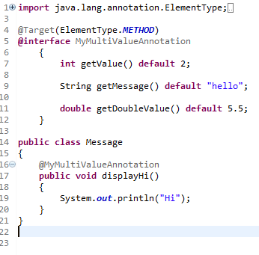
@Target Annotation
This is how we can specify annotation for method.

Slide 3
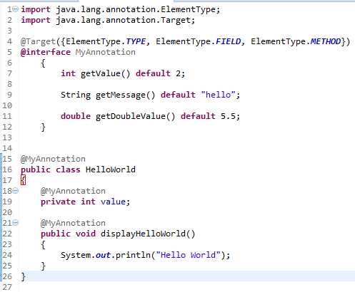
@Target Annotation
This is how we can specify annotation for a class, methods or fields

